Slide 1

Analysis on food manufacturing dataset
By Atif salam

Slide 2
Introduction
Food is part and parcel of life and people look for meals, food products, food businesses and restaurants over internet all the time. Competitors also seek information about each other in the food industry. This leads to investments in food technology as well. From the given dataset that we will work on emphasis on the Food sales of a particular company. This food database facilitates users in accessing information and an additional advantage of these databases is that the users can manage their health and make healthy eating decisions.

Slide 3
Objectives
This data contains 7071 counts of sales data for different products across various stores in different cities. The main objective is to understand whether specific properties of products and/or stores play a significant role in terms of increasing or decreasing sales volume. To achieve this goal, we will build an extensive model in SQL and find out the sales of each product at a particular store by viewing in charts. This will help Superstores to boost their sales by learning optimised product organization inside stores

Slide 4
Dataset Attributes
Fields include:
Item_Identifier - Unique identifier for each product.
Item_Weight – Product weight.
Item_Fat_Content – Fat content of the product.
Item_Type – Product category.
Item_MRP – List price of the product.
Outlet_Identifier - Unique identifier for each store.
Yr_since_Inception - the beginning of an official activity
Outlet_Size - The size of the store.
Outlet_Location_Type - The type of city in which the store is located.
Outlet_Type - Whether the store is a grocery store or a supermarket.
Item_Outlet_Sales - Sales of the product in each store.
The field include as follows

Slide 5
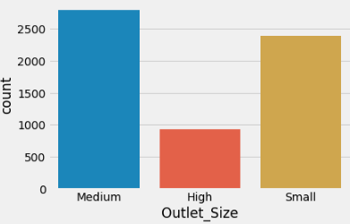
1. Outlet size wise sales impact
Insight : As per the table we can see the supermarkets and low market types are spread vastly in medium wise location. Less no. of high outlet type is present

Slide 6
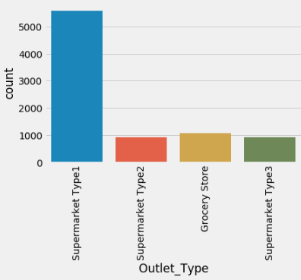
2.Outlet wise sales impact
Insight : As per the given table, these are the total sales of each super market. Tier 1 consist of majority hence its sales is higher among others.

Slide 7
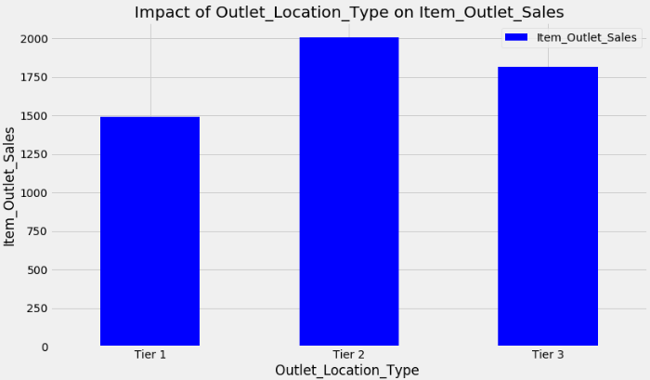
3.Location wise sales impact
Do Tier 1 cities have higher sales? This was one of the premisses we made in the start of this study. However, if we look at our results we see that in fact it is stores from Tier 2 cities that present the highest results, followed by Tier 3 cities and with Tier 1 cities with the lowest results of the three type of locations.

Slide 8
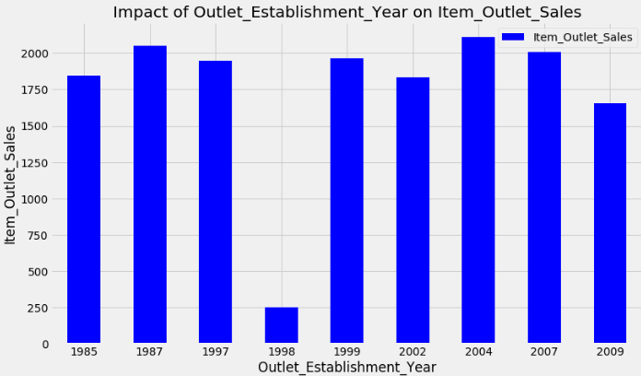
4.Outlet Establishment year and item outlet sales impact
There seems to be no significant meaning between the year of store establishment and the sales for the items. 1998 has low values but thet might be due to the fact the few stores opened in that year.

Slide 9
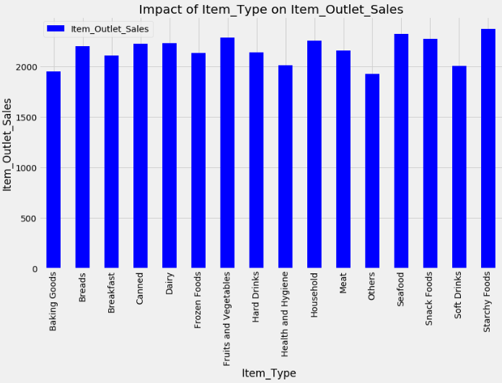
6.Analysis of Item type on item outlet sales
The location of product in a store will impact sales. Ones which are right at entrance will catch the eye of customer first rather than the ones in back.
The more the visible the item is the less higher. . This might be due to the fact that a great number of daily use products, which do not need high visibility, control the top of the sales chart

Slide 10
Insight summary
Sales of Tier 2> Sales of Tier 1 > Sales of Tier 3
Item Type does not influence the item sales much.
Tier 2 & Tier 3 cities have better sales than Tier 1 cities.
Key factors: Outlet type and Item MRP are the key factors affecting the outlet sales.
Clearly the MRP of a product will impact its total sales. This is true of any item in any location.
Outlet_Type is a major factor in how much of an item is sold, primarily as a result of the high variation between sales at grocery stores vs. supermarkets. It would be interesting to take grocery stores out of the equation entirely in order to observe the resulting impact on Outlet_Type importance
Attributes such as Item_Fat_Content turn out to be relatively insignificant when it comes to overall sales. This is likely because consumer choices with respect to nutrition, etc., are not homogenous throughout the customer population. Also, ‘Low_Fat’ does not necessarily mean ‘nutritious’, and with this dataset we don’t have access to information such as whether these items were specifically advertised as low-fat/healthy, or whether that was just Food Stores catoregization.
One other note I will mention is that personally I thought Outlet_Location_Type might play a larger role in determining sales figures. However, I suppose the location of a given outlet has more impact on the outlet’s total sales and turnover, as opposed to the sales of unique items. For instance it stands to reason that outlets located in urban areas with a larger customer base would stock a wider variety of products, and maybe have less room to boost individual items’ visibility numbers.

Slide 11
conclusion
After the detailed study of the food stores we can reach to a conclusion that if the superstores were to try to increase sales at all locations, it may consider switching more locations to Supermarket Type3 or 1. Other things they could do to increase sales is to see which Items had the highest sales. They may also consider how product visibility affected outlet sales. However, as per the analysis in this report should be good for helping the Food stores predict future sales at its locations. Various stakeholders concerned with sales information can also provide more inputs to help in hypothesis generation and more instances can be taken into consideration such that more precise results that are closer to real world situations are generated

